Slide 1
Similes , Idioms , and Homophones
BY Kezmen and Rylee

Slide 2
What is a simile?
A way of describing something by comparing it with something else. Also use like and as in your simile.

Slide 3
First simile sentence.
The girl is as skinny as a string of hair.

Slide 4
Second simile sentence
I have a kick like a soccer professional .

Slide 5
An idiom is …
A commonly used expression or a phrase that means something different from what it appears to mean.

Slide 6

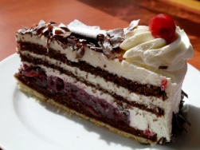
Sample Idiom sentence 1
School is a piece of cake for my older brother in third grade
Third grade is easy for older siblings.

Slide 7
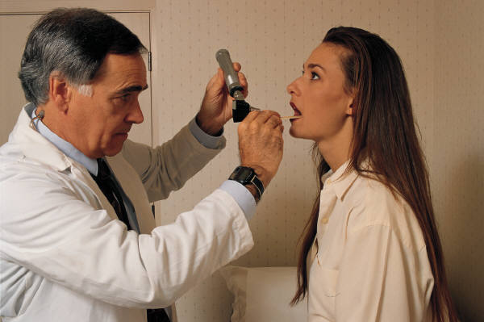

Sample Idiom sentence 2
There's a frog in her throat today .
Sounds like your sick.

Slide 8
A homophone is ...
2 words that sound the same but have different meanings and are spelled differently.

Slide 9

Homophone sentence 1
You are right I need to write like this!

Slide 10

Homophone sentence 2
Before I die I want to dye my hair.

Slide 11
Closing sentence
Similes, Idioms and Homophones are not the same at all but are close friends.

